Slide 1
Perception of conflict in the U.S. and U.K. over the Palestine issue
Ahmet Yusuf Aydın
M. Fuat Kına
Selim Yaman

Slide 2
Research Question
How does the use of violence by the actors change the public attitudes towards the Palestine-Israel conflict in the recent Sheikh Jarrah events, comparatively for the U.S. and the U.K. cases?
Methodology Overview:
Structural topic modeling (STM)
Twitter API

Slide 3
Outline
1. Search string (keywords)
2. Timeline for the May 2021 events
3. Downloading tweets
4. Pre-processing and descriptive statistics
5. Structural topic modelling
6. Findings
7. Limitations

Slide 4
1. Search string (keywords)
query <- c("israel", "hamas", "jews", "jewish", "palestine", "palestinian", "gaza","quds","jerusalem", "semitism", "tel aviv", "telaviv", "sheikh jarrah", "sheikhjarrah","jarrah")
Starting with place names
The risk of selection bias against pro-Israel accounts

Slide 5
2. Timeline for the May 2021 events
6 May: Two civilians were killed by Israel police forces.
10 May (10:00 pm): Hamas counter-attacks over Israel (rockets from Gaza).
21 May: Ceasefire!

Slide 6
3. Downloading tweets
Why we needed academictwitteR package:
Time frame options
Large volume of accessible data
Errors on the twitter side
The final scope of our data:
US: 41604
UK: 15569
Total N = 57173

Slide 7
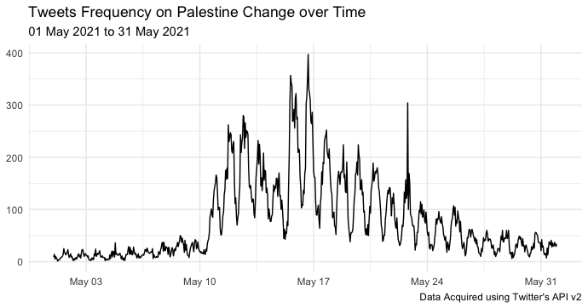
May 2021...

Slide 8
4. Pre-processing and descriptive statistics
Removing punctuations, numbers, symbols, stopwords, stemming, lowercase:
Stopwords (source = "smart")
We divide our sample by two factors:
Before and after 11 May, when Hamas starts counter-attacks
Two cases: U.S. and U.K.

Slide 9
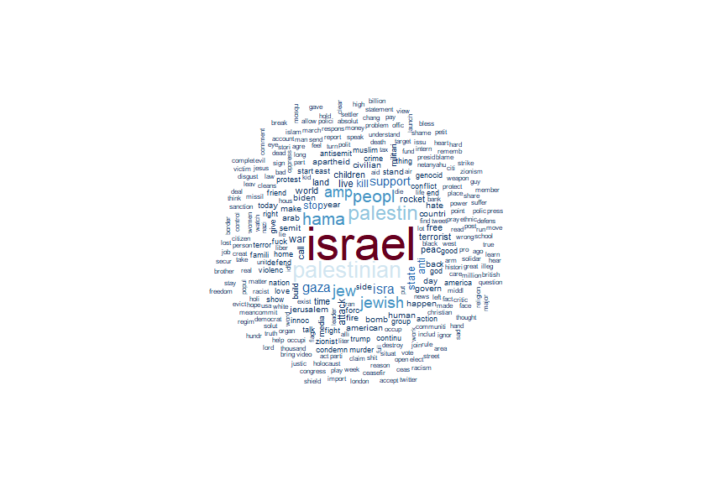
Wordcloud

Slide 10
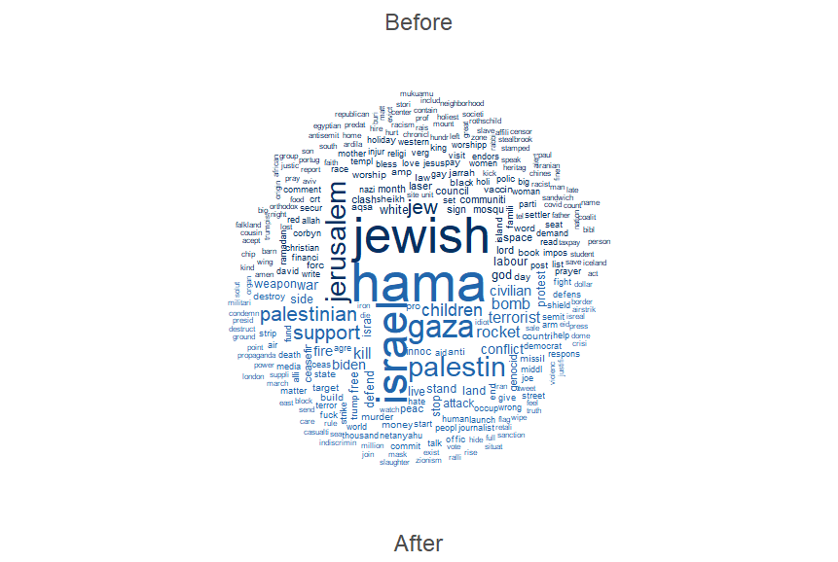
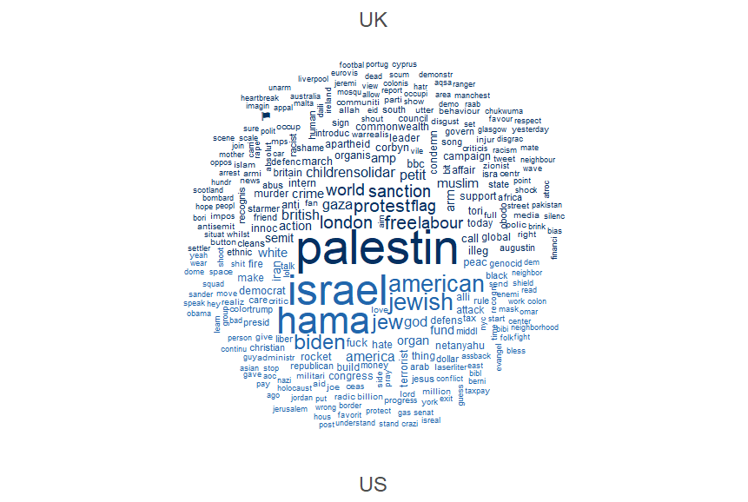
Wordclouds: for the time threshold and country variables

Slide 11
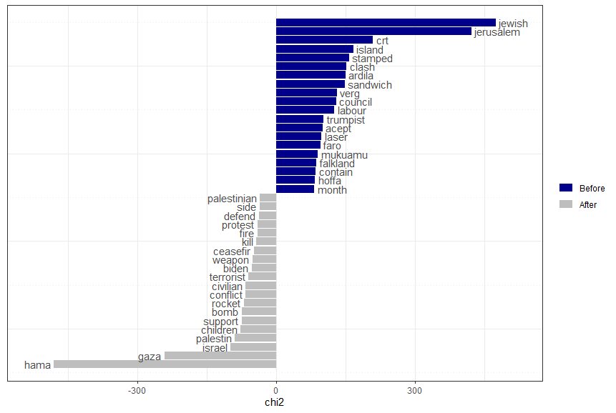
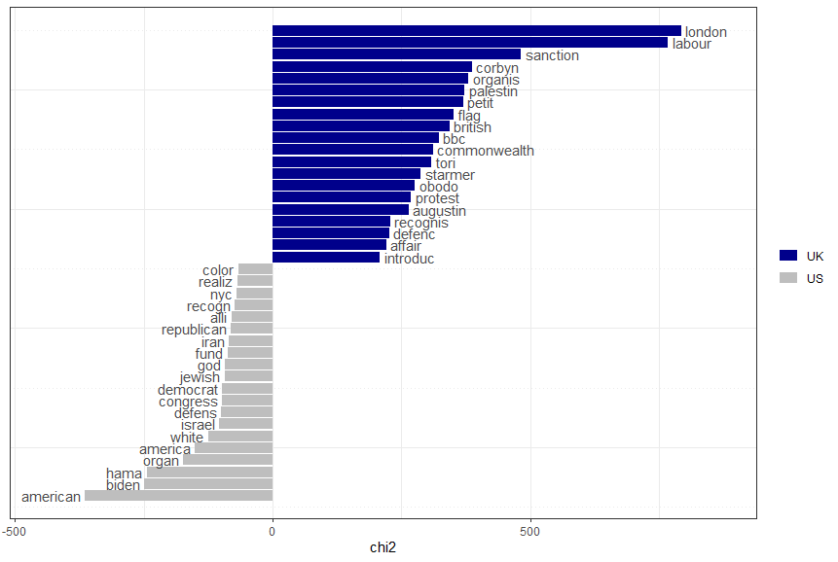
Textstats / Keyness: for the time threshold and country variables

Slide 12
5. STM
Why not LDA?
US vs UK, before and after Hamas rockets
Why not stLDA?
considers twitter users as well, but code limitations and lack of metadata
Trimming: minimum (0.001) vs. maximum (0.25)
prevalence = ~ threshold + US + s(day)

Slide 13
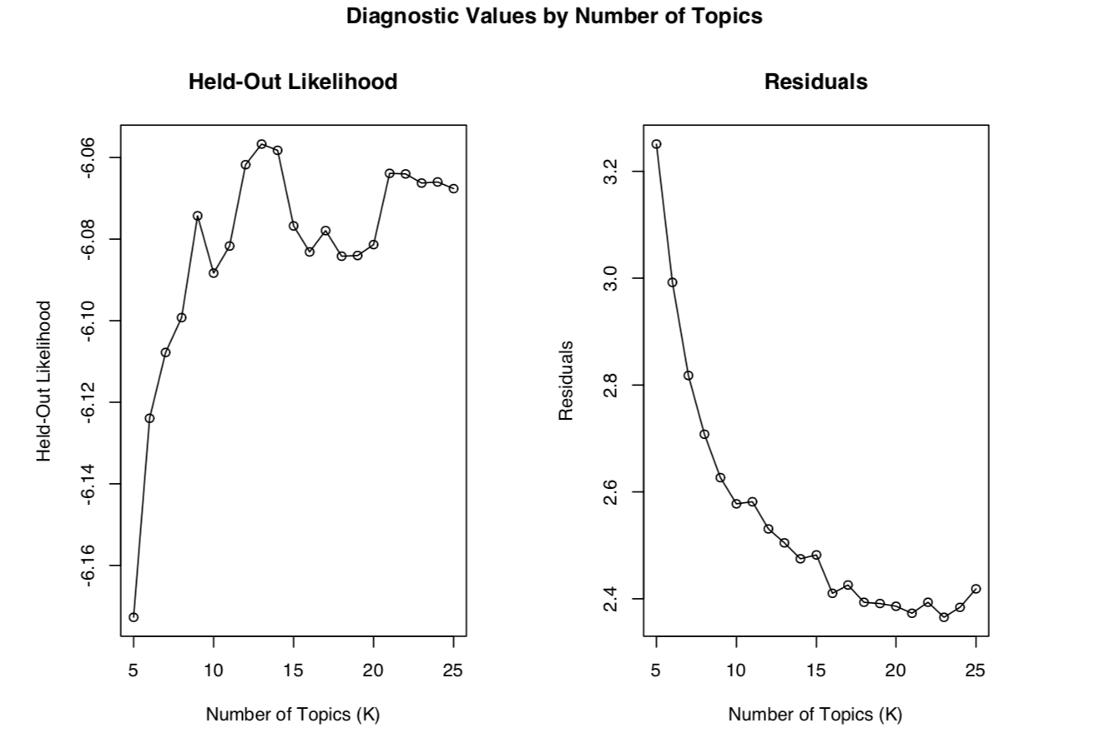
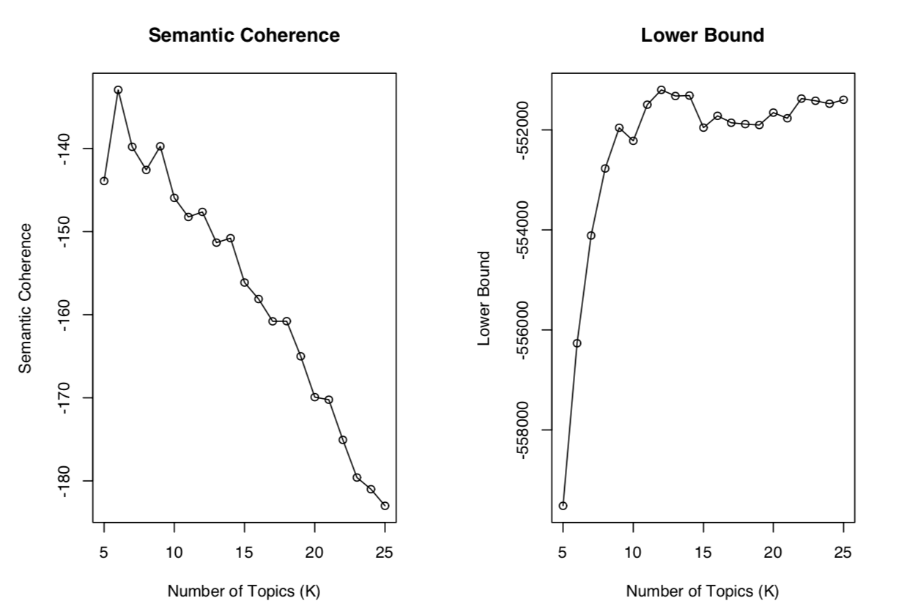
STM: How Many Topics?

Slide 14
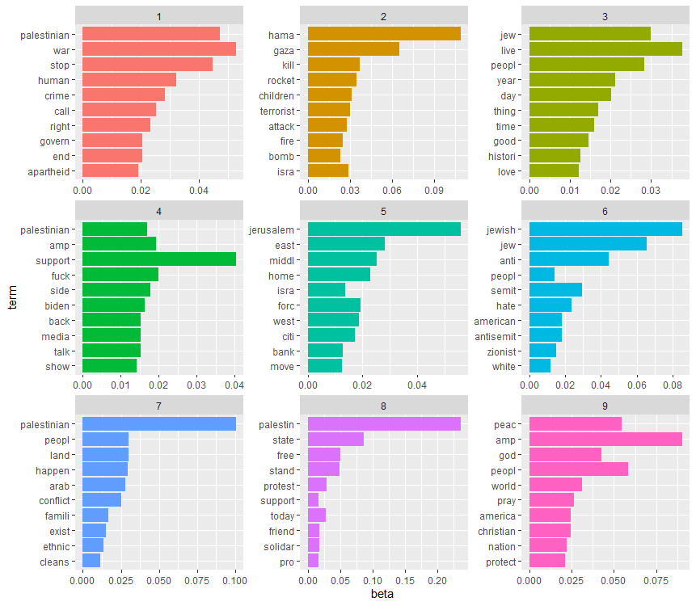
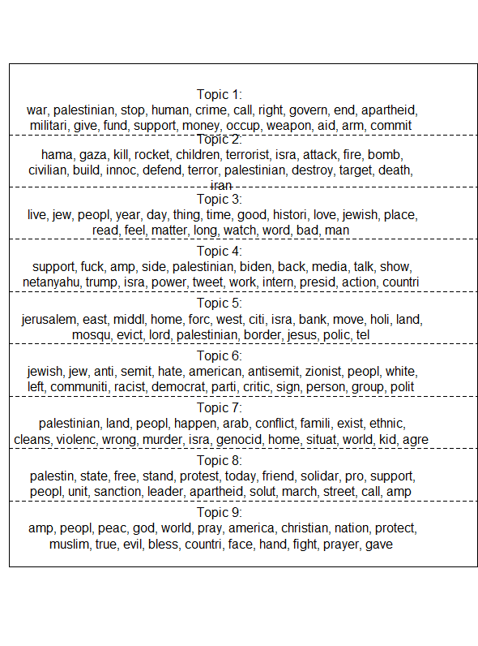
6. Findings
Violence/
Armed Conflict
Apolitical/
Positive
Humanitarian
US Politics
Settlement
Antisemitism
Activism -
Call for Protest/Action
Ethnic
Religion

Slide 15
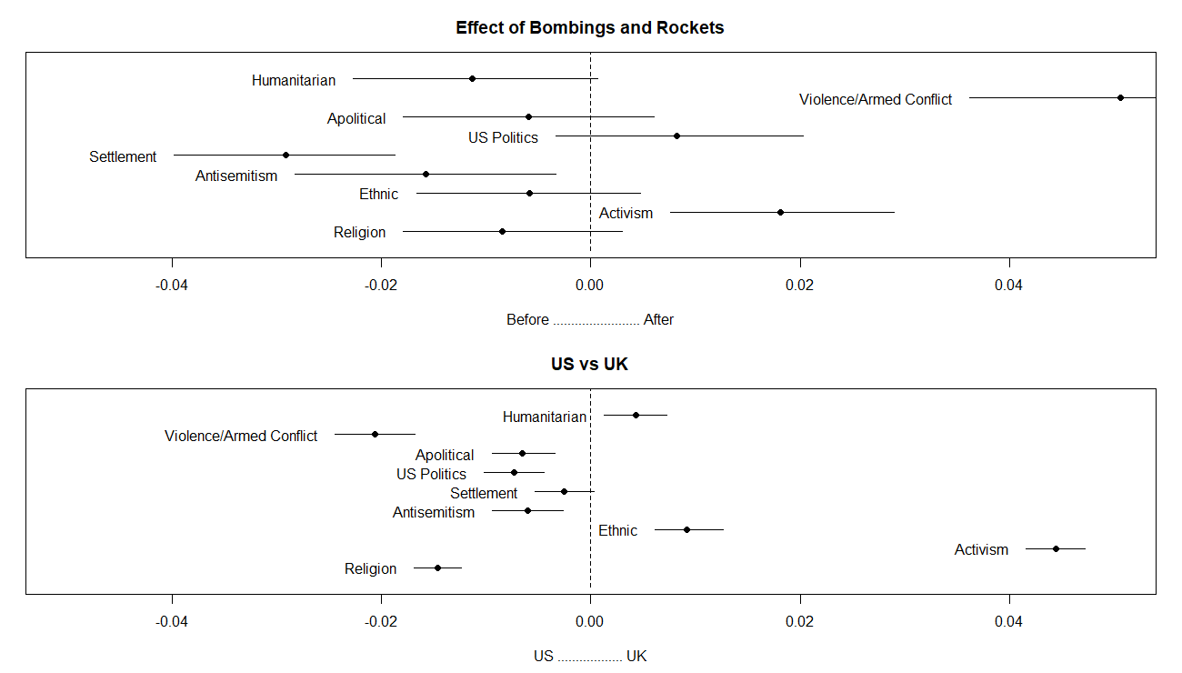

Slide 16
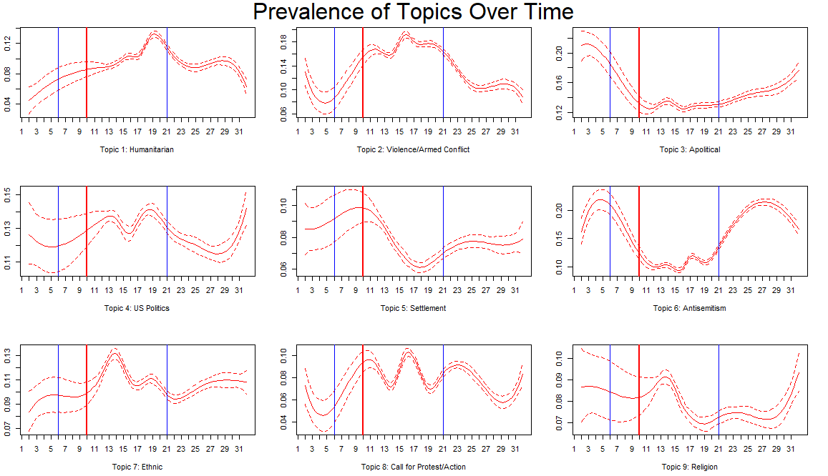
Notes:
Topic8: haftasonu

Slide 17
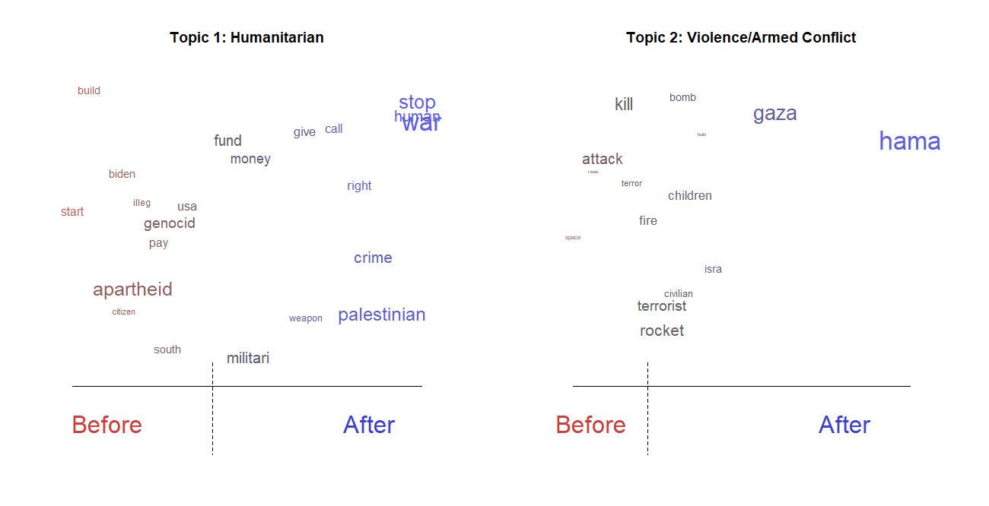

Slide 18
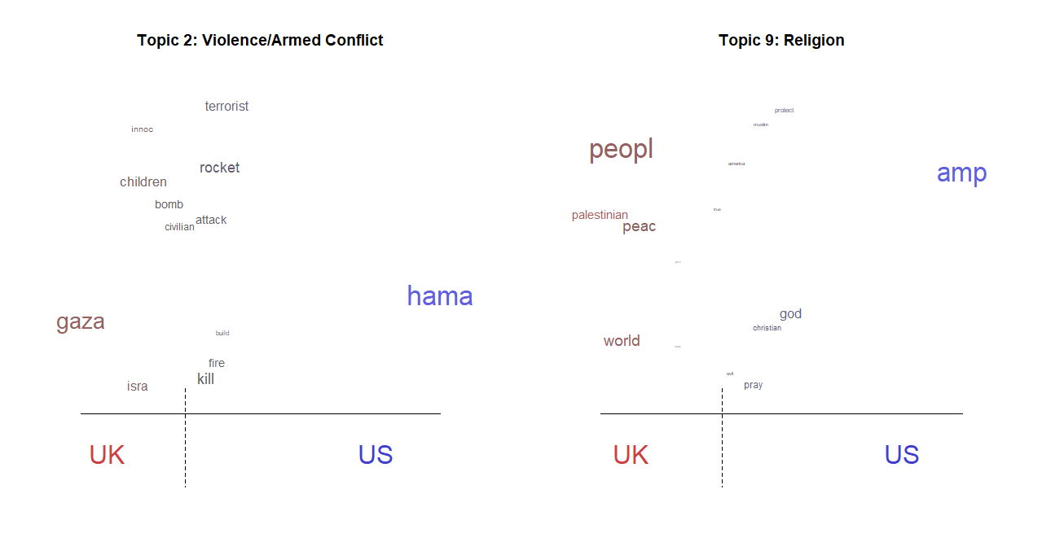

Slide 19
7. Limitations
Lack of causal inference
Ideology estimation
Limited number of tweets
More conflict events

